Slide 1

Arduino Robot Maze Solver
Embedded Systems EE314
Supervised by:
Prof. Ahmed Sedik
Group Members:
Omar Alaa 171385
Omar Khaled 171033
Omar Adel 171112
Yousef Sherif 171181
Ramez Mohammed 171113

Slide 2
.
Introduction
.
Components and Equipments
.
Coding
.
Steps of Work
.
Conclusion
Contents
1

Slide 3
Introduction
Modern robotics technologies are focused on developing self-navigating autonomous robots to automate our day-to-day processes. This means that most of the research focuses on improving sensors and algorithms to build flexible and accurate robots.
The maze solving robot — also known as a micro mouse — is designed to find a path without any assistance or help. As a type of autonomous robot, it has to decode the path on its own to solve the maze successfully. So it’s logic is quite different from the line following robot which follows a predetermined route. These types of autonomous mobile robots can be used in a wide variety of applications such as material handling, warehouse management, pipe inspection, and bomb disposal.
In this project, we will build a simple Arduino maze solving robot using three ultrasonic sensors.
2

Slide 4
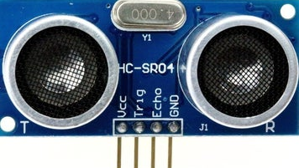
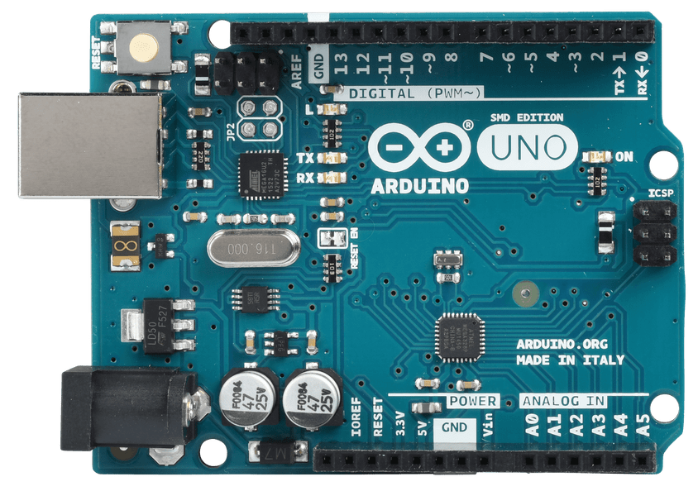
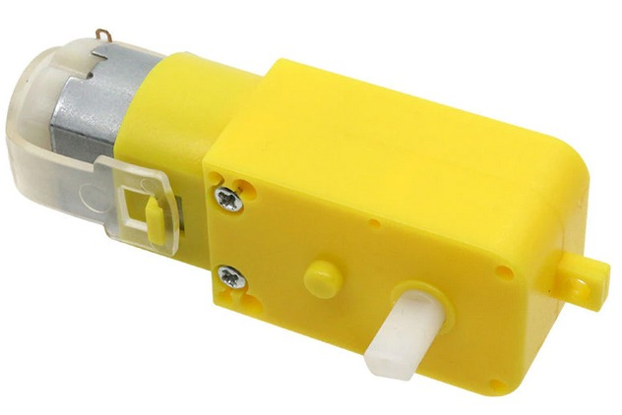
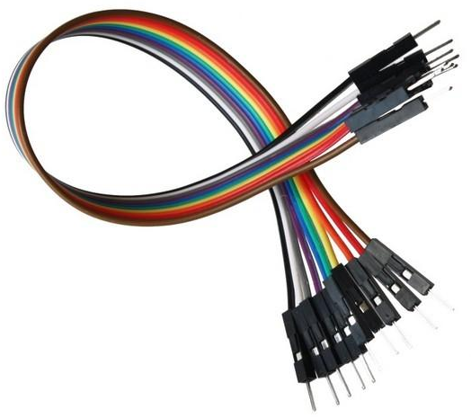

Components
Component Name: | How many: | Image:
Ultrasonic Sensor | 3
Arduino Uno | 1
DC motors | 4
Wires | 25
1.5v Battery | 4
3

Slide 5
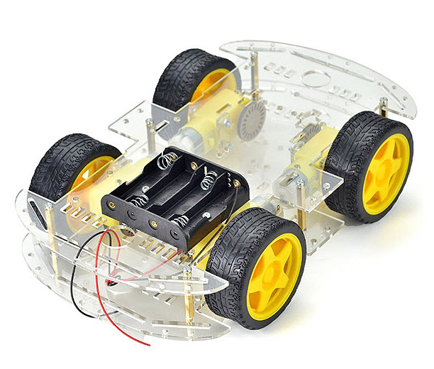
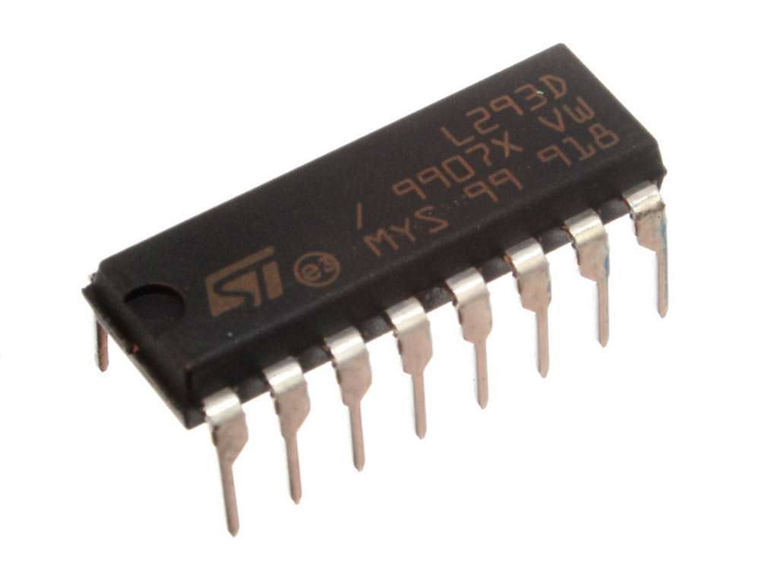
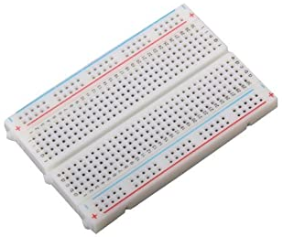
Components
Component Name: | How many: | Image:
Robot Body | 1
L293D 4 Channel driver – H Bridge | 1
Breadboard | 1
All Equipments and components where bought from:
https://ram-e-shop.com/
All Details in the link above
4

Slide 6
Steps of Work
Algorithm:
Maze solving robot is one of the most popular autonomous robots.Our maze solving robot make multiple runs in the maze, first it creates a map of maze layout and store it in its memory, then run through a shortest path, this is done through LSRB
Hardware:
In our robot we are using Arduino Uno board, it acts as the brain of our robot because all the decisions which is taken by the robot to solve the maze is governed by this board and three ultrasonic sensors are used to take the input. The robot is capable of scanning the obstacles with the help of ultrasonic sensors; they transmit ultrasonic waves from its sensor head and again receive the waves reflected back from the object. By measuring the delay of time from the transmission to reception of sonic wave, it detects the position of the object or wall. And then move according to the algorithm avoiding all the obstacles and reach the final destination. Also this robot has a special feature of navigating through human control for that we are using Bluetooth module, this feature can be used in extreme cases when there is a requirement of human control decision making.
5

Slide 7
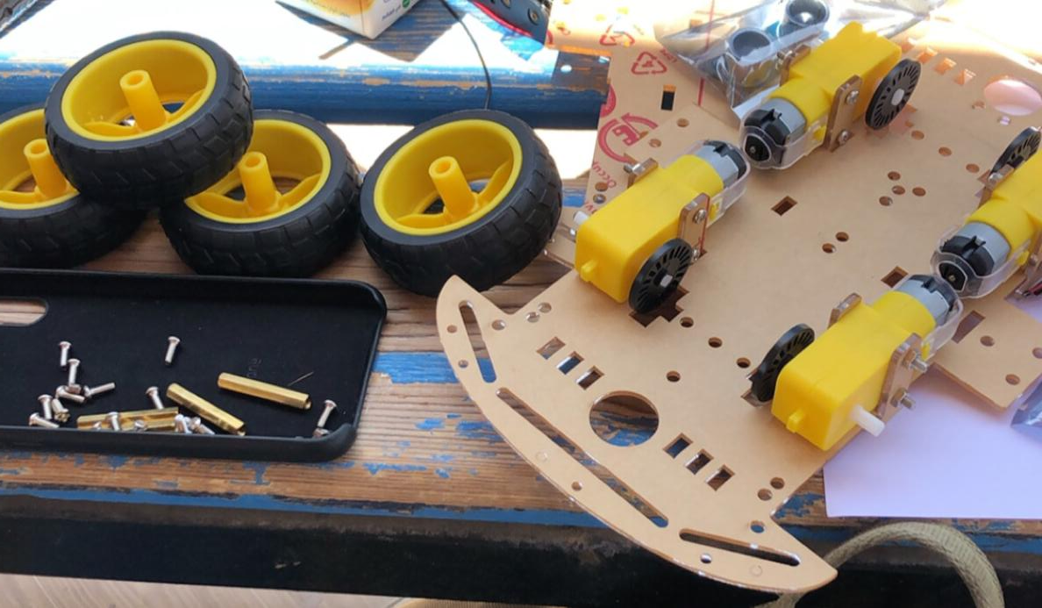
Implementation
Firstly we start fixing the motors in the robot body and then attach the wheels into each motor
And then fix the bottom part of the body with upper. After that we start attaching the sensors and the Arduino Uno in the upper part of the body
6

Slide 8
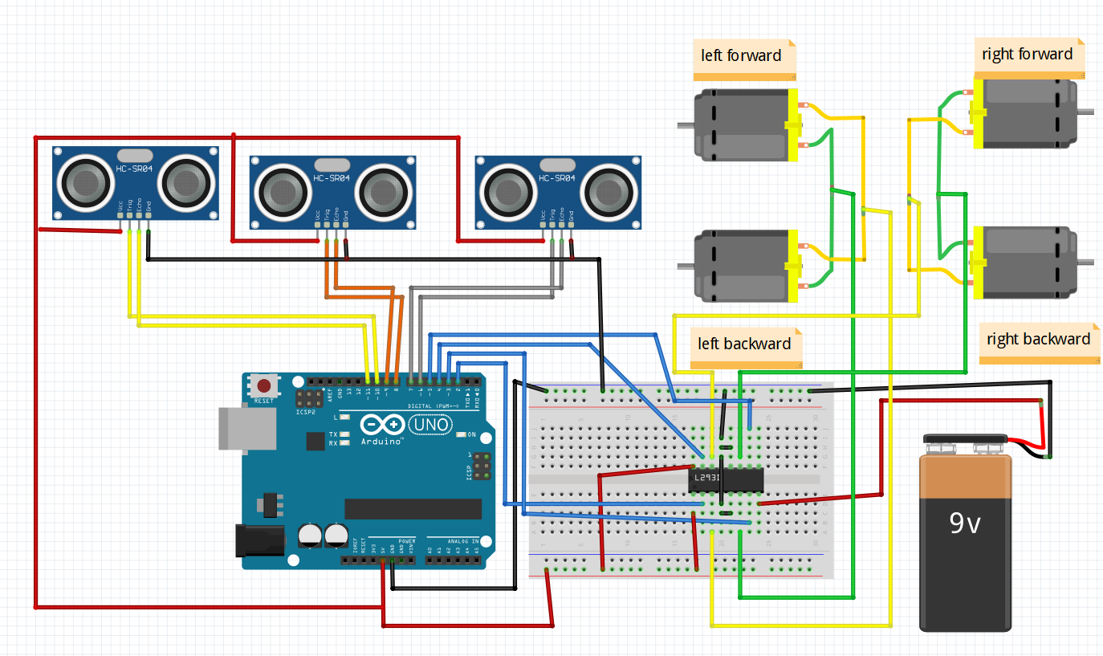
Wiring
Here is a schematic diagram of the robot. these connections are related to the code
7

Slide 9
Wiring
Parts: Sensors
"The Ultrasonic sensor"
An Ultrasonic sensor is a device that can measure the distance to an object by using sound waves. It measures distance by sending out a sound wave at a specific frequency and listening for that sound wave to bounce back. By recording the elapsed time between the sound wave being generated and the sound wave bouncing back. This seems similar to the working of Sonar and Radar.
The connection of the Ultrasonic Sensor to the Arduino:
GND pin is connected to the Ground.
VCC pin is connected to the Positive (5v).
Echo pin is connected to the Arduino. (choose any pin and match it to the code)
TRIG pin is connected to the Arduino. (choose any pin and match it to the code)
You will make a common Ground and connect all GNDs to it ( sensors, Arduino, Driver ) all grounds should be connected.
For Vcc Pins also connect the 3 Sensors to a 5v Pin
( you can connect them to the Arduino Or the Driver I recommend the Driver)
Note: Don't connect the Sensors to a voltage higher than 5v or it will be damaged.
8

Slide 10
Wiring
Motor Driver
The L298N H-bridge: it's an IC that can allows you to control the speed and direction of two DC motors, or control one bipolar stepper motor with ease. The L298N H-bridge driver can be used with motors that have a voltage of between 5 and 35V DC.
There is also an on-board 5v regulator, so if your supply voltage is up to 12v you can also source 5v from the board.
Consider the image – match the numbers against the list below the image:
1-DC motor 1 “+”
2-DC motor 1 “-”
3-12v jumper – remove this if using a supply voltage greater than 12v DC. This enables the on-board 5v regulator
4-Connect your motor supply voltage here, maximum of 35v DC.
5-GND
6-5v output if 12v jumper in place
7-DC motor 1 enable jumper. Remove the jumper and Connect to PWM output for DC motor speed control.
8-IN1 Direction Control
9-IN2 Direction Control
10-IN3 Direction Control
11-IN4 Direction Control
12-DC motor 2 enable jumper. Remove the jumper and Connect to PWM output for DC motor speed control
13-DC motor 2 “+”
14-DC motor 2 “-”
.
9

Slide 11
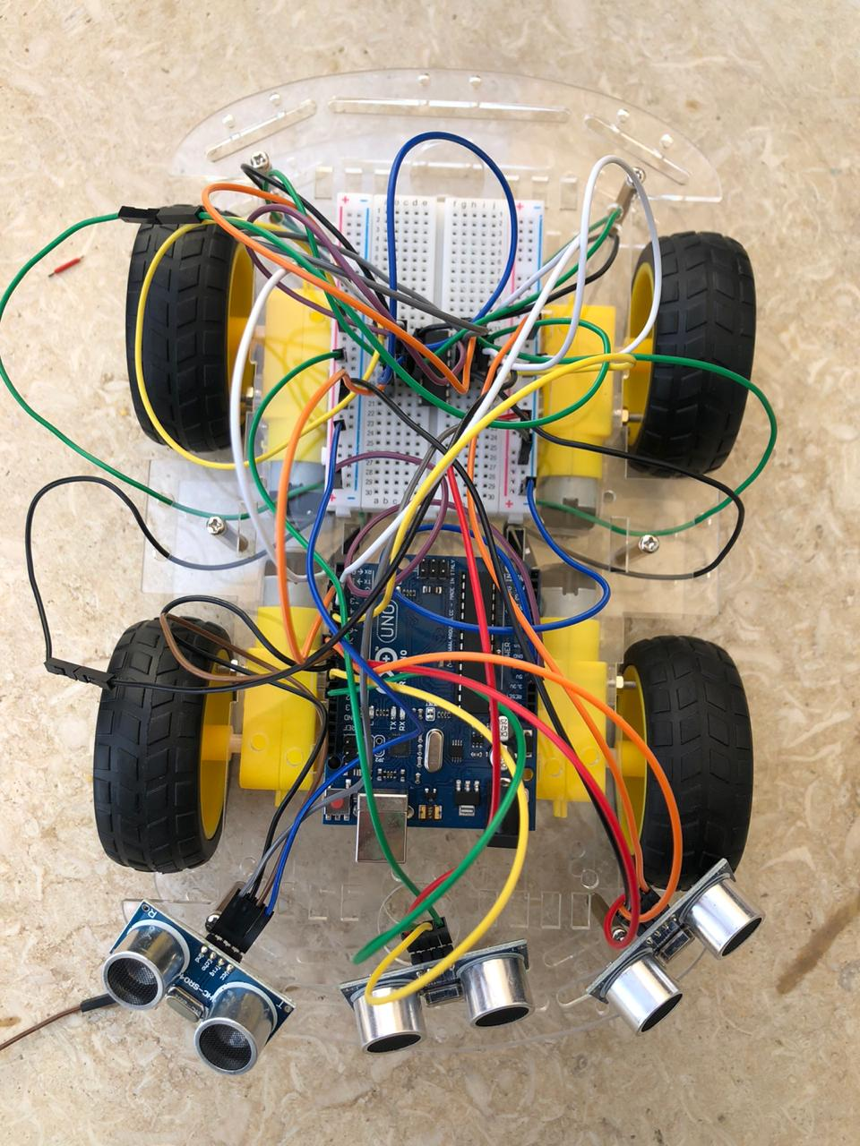
Wiring
A final picture of the robot after wiring:
10

Slide 12
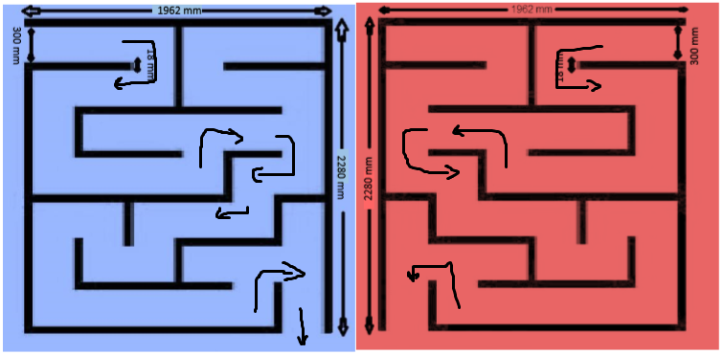
Coding
The main idea is to avoid hitting walls and to get out of the maze. we had 2 simple mazes and I had to keep that in mind because they were different.
The blue maze uses right wall following algorithm.
The red maze uses left wall following algorithm.
The photo above shows the way out in both mazes.
Code flow:
1-defining the pins
2-defining output and input pins
3-check sensors' readings
4-use sensors' reading to define walls
5-check first route (if it was left then follow the left wall, if it's right follow the right wall)
6-Use PID to avoid hitting the walls and to control motors' speed
11

Slide 13
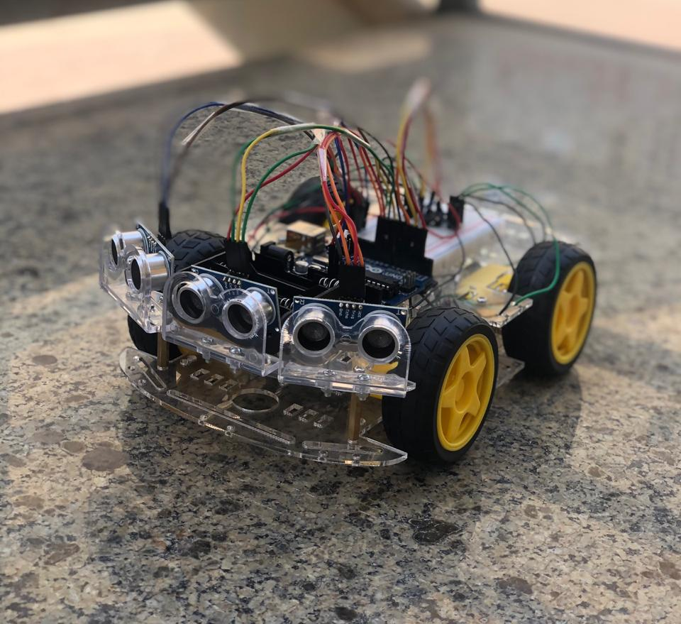
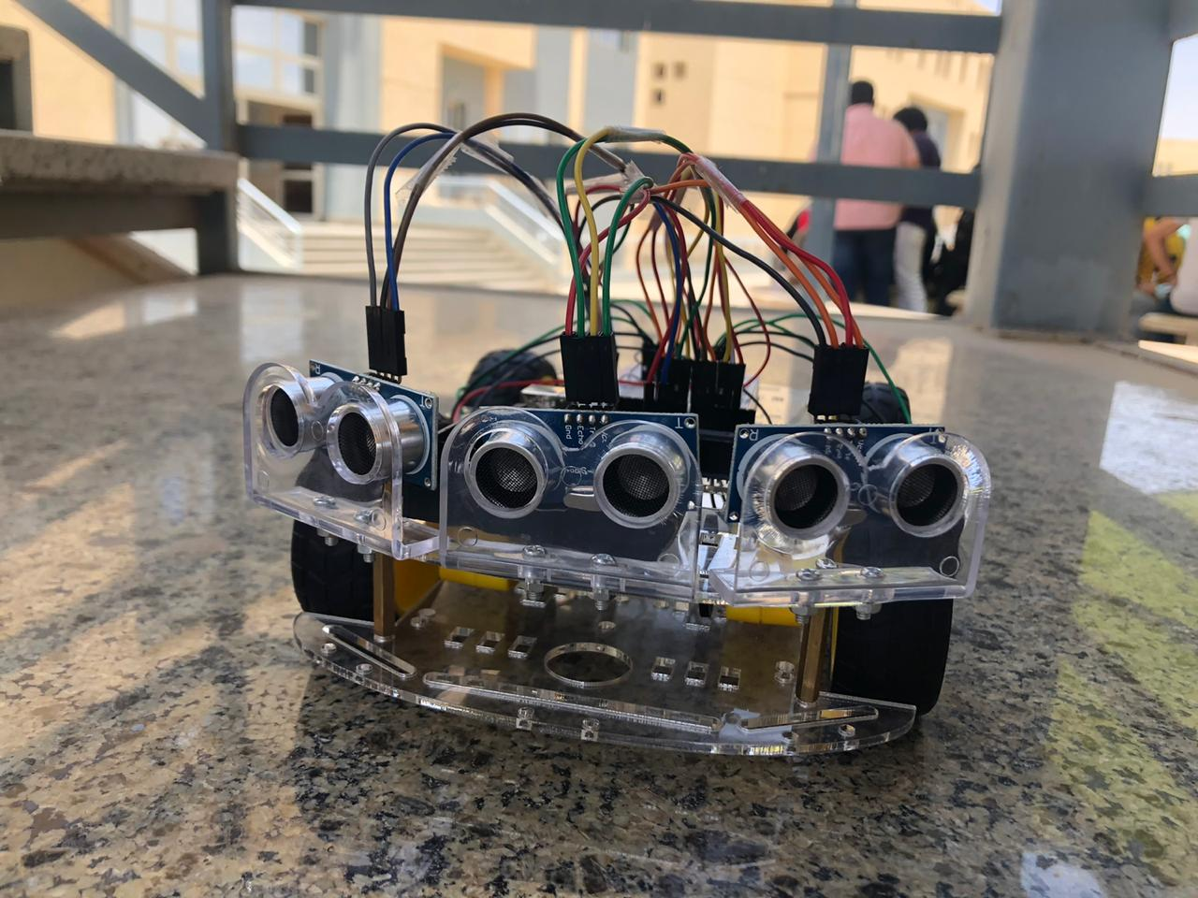
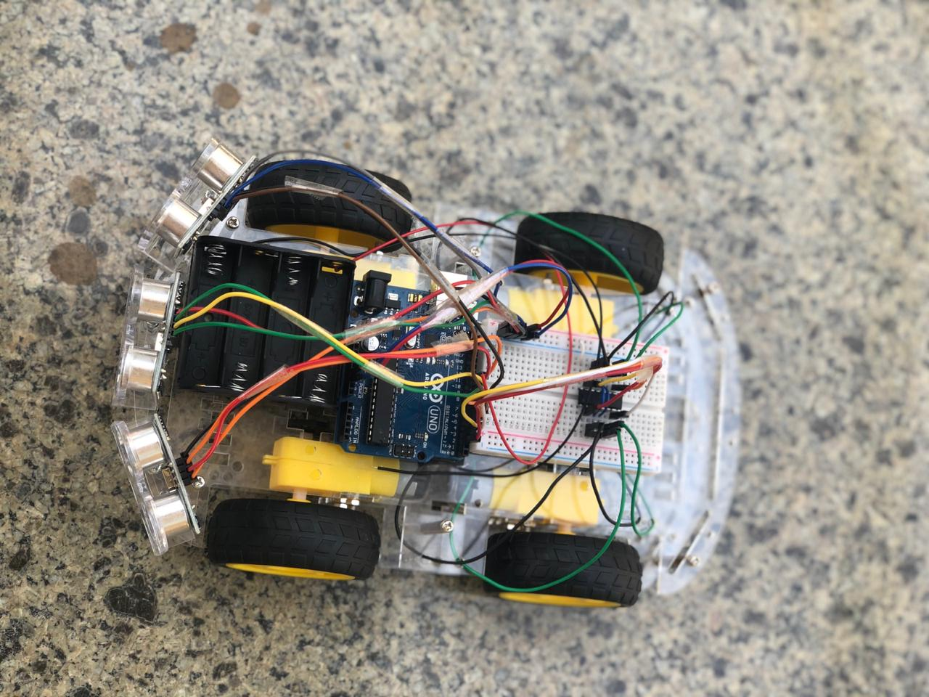
Conclusion
We finally ready to run the code and see the robot avoiding obstacles and walls
12

